Slide 1
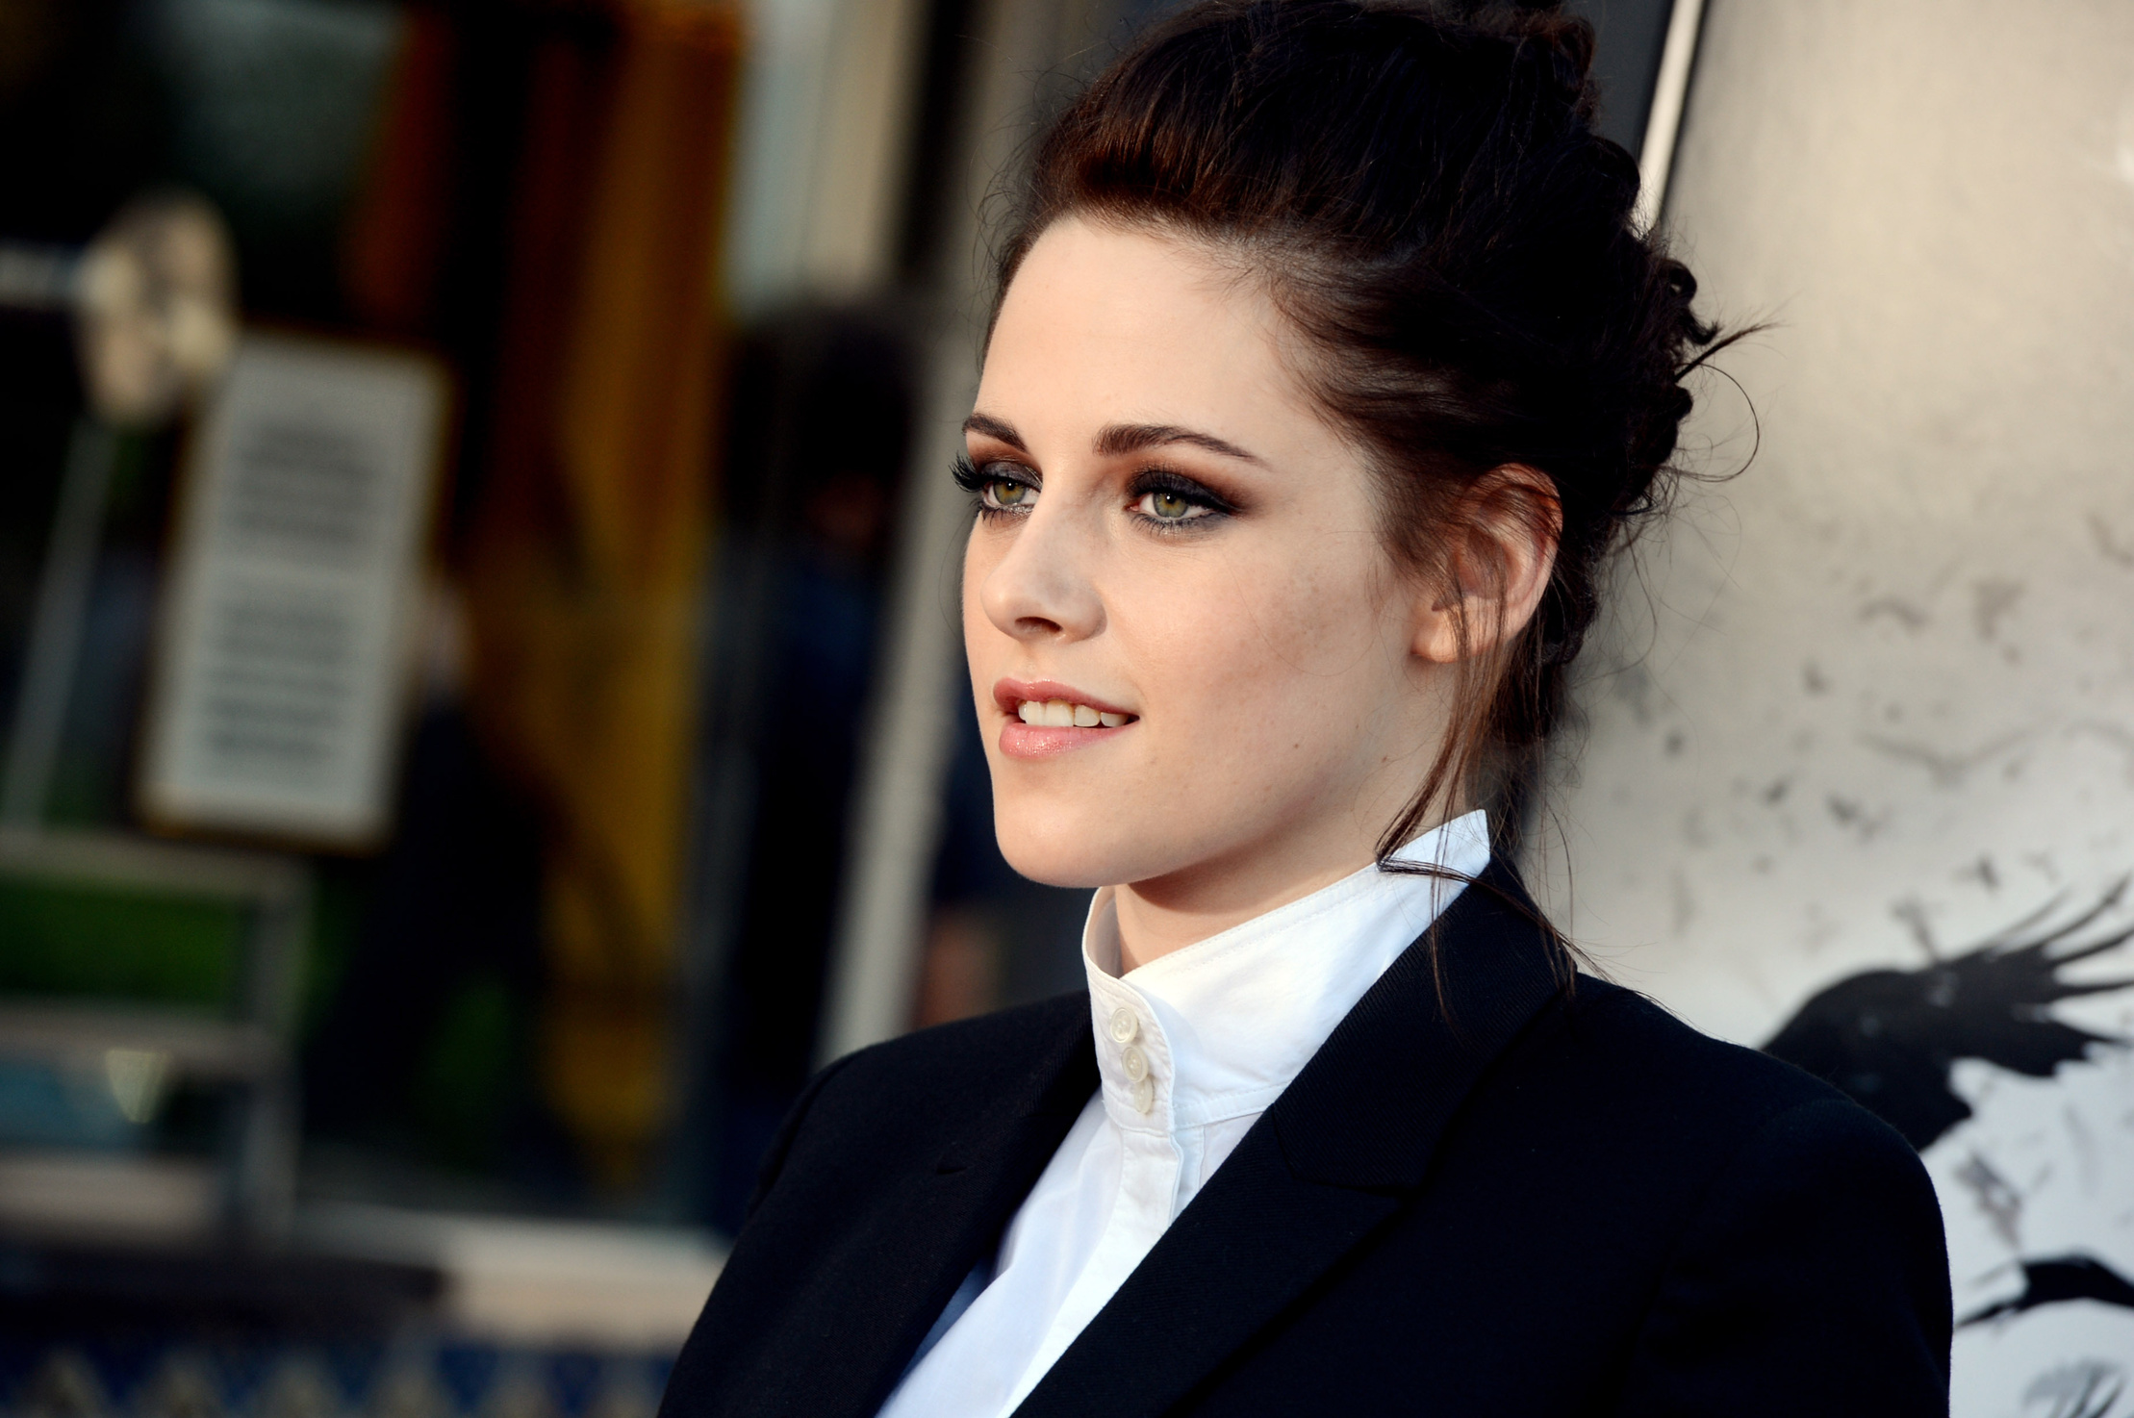
What is Grooming and Etiquette ?
Grooming refers to maintaining one's appearance, while etiquette refers to the rules of polite behavior in society.

Slide 2

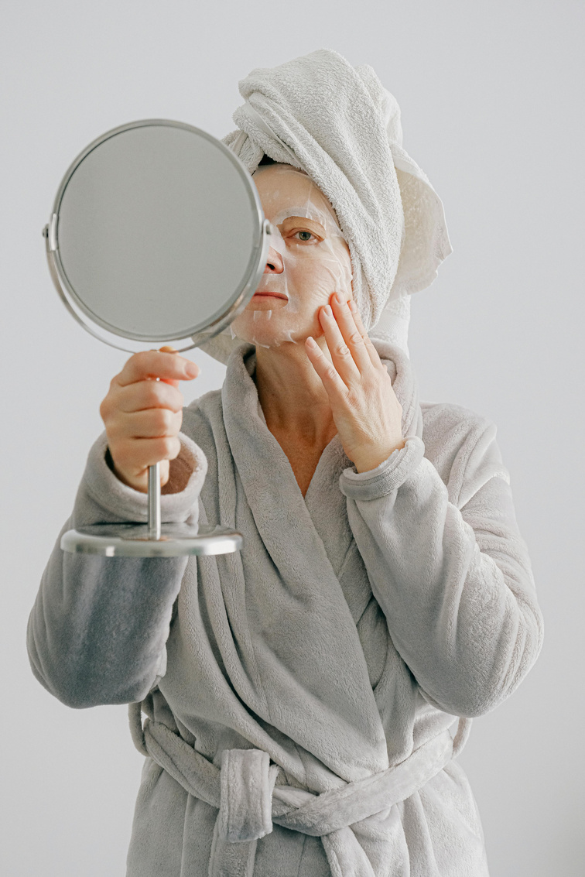

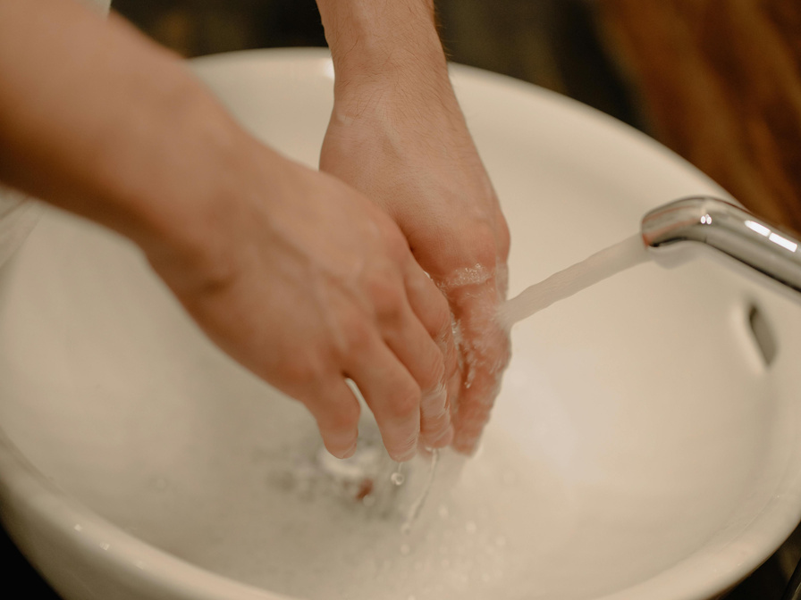


TYPES OF GROOMING & ENTIQUETTE
PERSONAL GROOMING
SOCIAL ENTIQUETTE
HYGIENE GROOMING
DINNING ENTIQUETTE

Slide 3
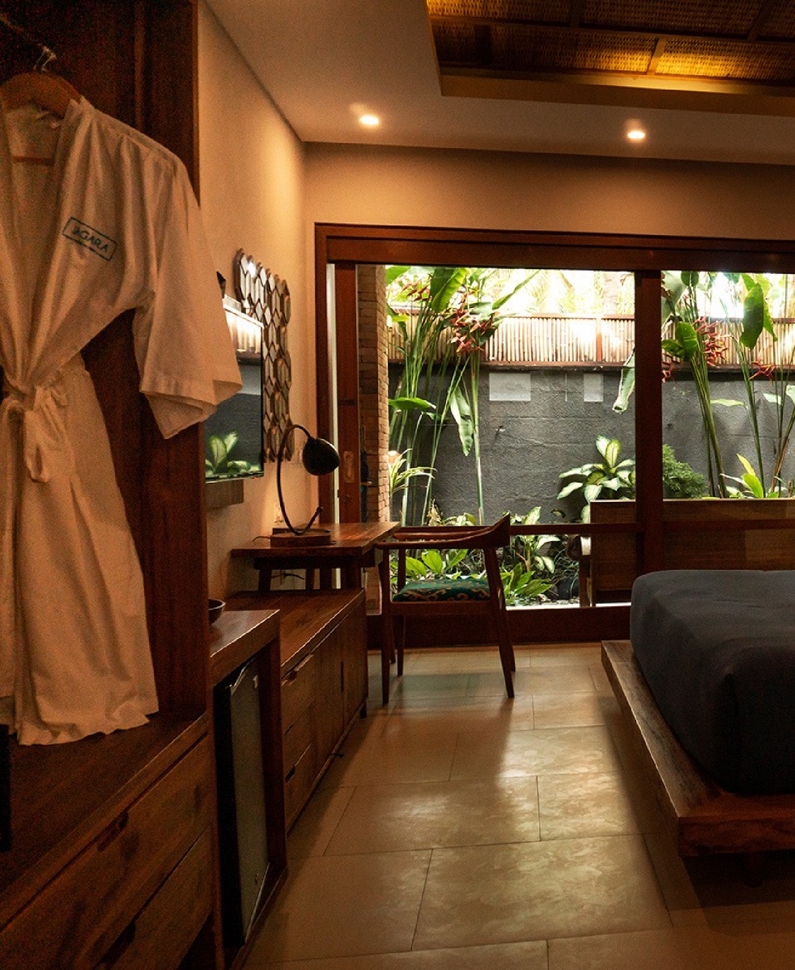
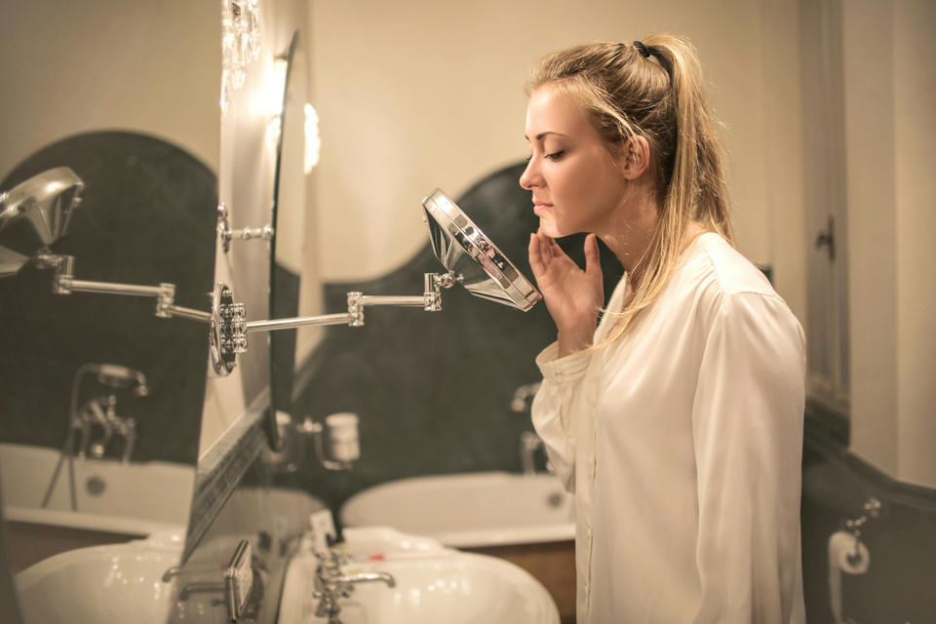
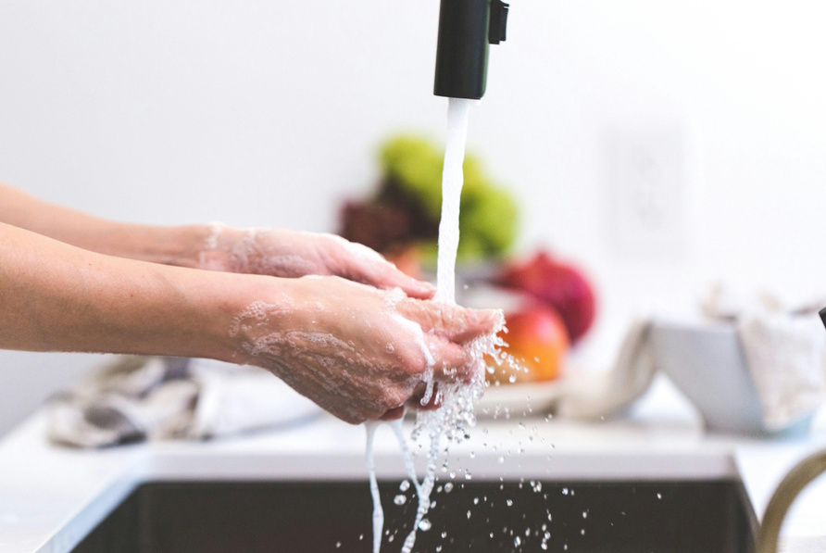
PERSONAL
& HYGIENE GROOMING
Maintaining good hygiene and grooming practices not only enhances physical appearance but also promotes overall health and confidence. Regular habits like bathing, brushing teeth, and grooming hair contribute to a positive self-image and well-being.

Slide 4


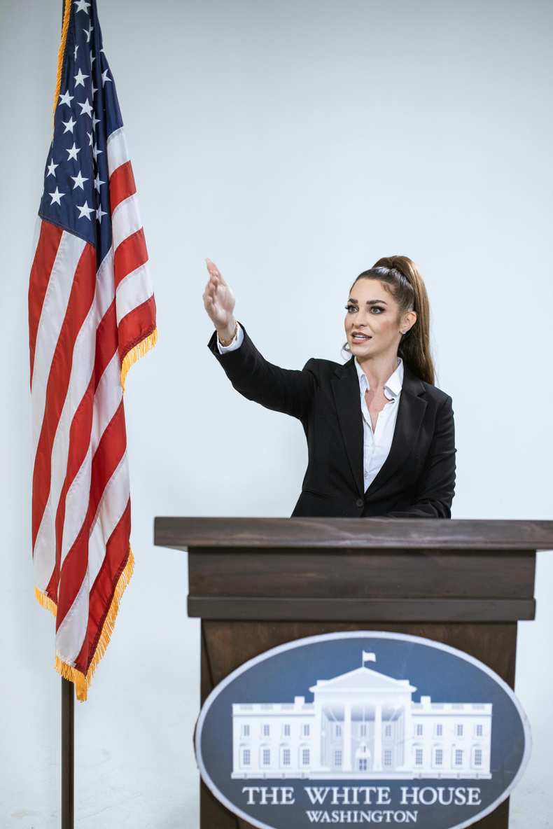
SOCIAL ENTIQUETTE
It includes using proper table manners while dining, being punctual for meetings, dressing appropriately for the occasion, and being respectful while communicating with others.

Slide 5

In conclusion,
Grooming and entiquette play essential roles and reflect one's attention to detail, self-respect, and consideration for others, ultimately contributing to overall confidence and success.
THANK YOU
G. PAVANI

